Slide 1
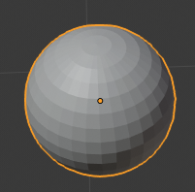

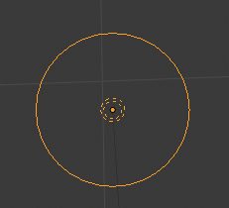


Linking mesh to light with custom properties
mesh
Associated light name
PointLight

Slide 2
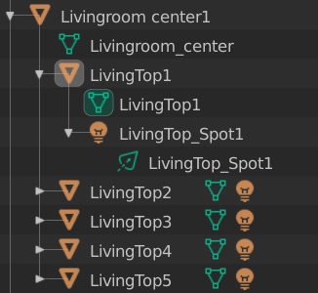

group name
Child Light

Slide 3
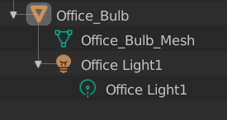

Associated light name
Child

